Slide 1
Study Abroad in Non-Traditional Areas: Facilitating Title VI/NRC Goals and Mission
Title VI @ 50 Conference
Washington D.C. March 20, 2009
John Metzler
African Studies Center
Michigan State University

Slide 2
Historical Background
Until 2003-2005 Title VI competition cycle NRCs not encouraged to promote study abroad as part of their mission.
Why?
** Lack rigor– “Safari”
**Elitist
**Safety & Health
**Logistical problems
** Lack of correspondence with the core mission/agenda of NRCs

Slide 3
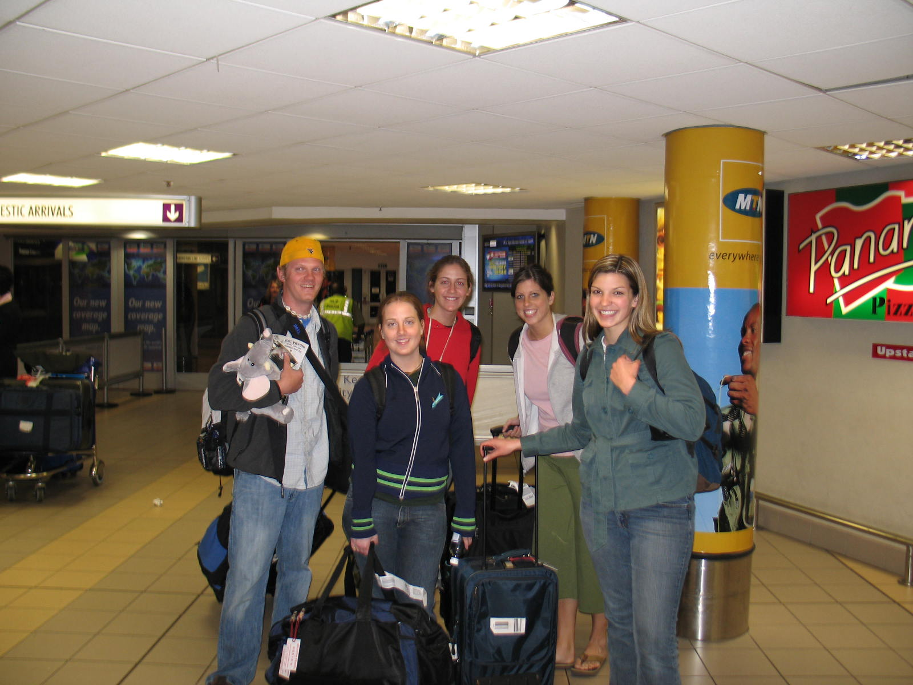
Historical Background
In last cycle (2006-2010) NRCs encouraged to promoted and record (courses) from study abroad programs.
Reflected in survey data:
** 97% of Africanist faculty at NRCs supported study abroad programs for undergraduates (Bowman, 2001)

Slide 4
Study Abroad Data: Non-Traditional Destinations
Rapid increase in study abroad by U.S. students, from 100,000 in 1996/97 to 241,000 in 2006/07 (Open Doors, 2008)
Yet, this represents just ONE per cent of U.S. under-graduates.

Slide 5
Study Abroad: Data on Non-Traditional Destinations
Top Destinations: (Top Ten)
United Kingdom: 32,109*
Italy: 27,831
Spain: 24,005
France: 17,233
China: 11,064
Australia: 10,747
Mexico: 9,461
Germany: 7,355
Ireland: 5,785
Costa Rica: 5,383
* more than one third of students to English speaking countries
( Num: 11-20)
Japan: 5,012
Argentina: 3,617
Greece: 3,417
South Africa: 3,216 (2,512)
Czech Rep: 3,145
Chile: 2,824
Ecuador: 2,813
Austria: 2,810
New Zealand: 2,718
India: 2,627

Slide 6
Study Abroad Data: Non-Traditional Destinations

Slide 7
Student Demographics
Race/Ethnicity | 1996/97 | 2000/2001 | 2006/2007
White | 83.9 | 82.9 | 81.9
Asian/Pacific Islander | 5.0 | 5.4 | 6.7
Hispanic or Latina(o) | 5.1 | 5.4 | 6.0
Black or African American | 3.5 | 3.5 | 3.8
Native American | 0.3 | 0.5 | 0.5

Slide 8
Disciplinary Fields of Study
Field of Study | 1996/97 | 2000/2001 | 2006/07
Social Sciences | 34.0 | 20.3 | 21.4
Business | 14.6 | 18.1 | 19.1
Humanities | NA | 14.5 | 13.2
Fine/Applied Arts | 7.1 | 8.5 | 7.7
Science (P & B) | 6.8 | 7.1 | 7.3
Foreign Language | 9.3 | 8.2 | 7.2
Education | 4.3 | 4.4 | 7.2
Health Sciences | 2.7 | 3.2 | 4.1
Engineering | 1.9 | 2.7 | 3.1
Math/Computer Sc. | 1.6 | 2.0 | 1.5
Agriculture | 1.2 | 1.6 | 1.5
Other | 7.8 | 4.9 | 6.6
Undeclared | 3.9 | 4.5 | 3.1

Slide 9
African Destinations
Top 10 (2006/2007:
**South Africa: 3,216
**Ghana: 1,645
**Egypt: 1,100
**Kenya: 686
**Tanzania: 630
**Morocco: 491
**Senegal: 475
**Uganda: 357
** Botswana: 194
Zambia: 133

Slide 10
African NRCs: Study Abroad Programs
INSTITUTION | SHORT-TERM PROGRAMS | AFRICAN LANGUAGE PROGRAM | EXHANGE AND/OR LONG TERM PROGRAMS | PROGRAMS THROUGH THIRD-PARTY VENDORS | TOATL PROGRAMS
Boston University | Dakar, Senegal | Niger (Hausa) | Niger | 0 | 2
University of California System (Education Abroad) | 0 | 0 | American U. Egypt U. of Ghana-Legon U. of KwaZulu-Natal U. of Cape Town | 0 | 4
University of Florida | Education in South Africa Senegal (Language) | Senegal (Wolof) | Un. Dar-es-Salaam Un. of Botswana | Arabic Language Institute in Fez | 5
University of Illinois | 0 | Arabic-Egypt | American University-Cairo University of Cape Town | CIIE programs University of Minnesota programs in Ghana, Senegal & Kenya | 2 (6)
Indiana University | Senegal (culture and language) | Senegal (Wolof) | Un. of Ghana-Legon Un. of Dar-es-Salaam University of Cape Town | 0 | 4
University of Kansas | Society, Politics & Culture, South Africa; Summer program in Zanzibar | Zanzibar (Swahili) Morocco (Arabic) | 0 | Summer Institute for Arabic in Ifrane, Morocco | 2 (1)

Slide 11
INSTITUTION | SHORT-TERM PROGRAMS | AFRICAN LANGUAGE PROGRAM | EXHANGE AND/OR LONG TERM PROGRAMS | PROGRAMS THROUGH THIRD-PARTY VENDORS | TOATL PROGRAMS
Michigan State University | Egypt (1) Ghana (3) Kenya (3) Madagascar (1) Mali (1) Malawi (1) Senegal (1) Tanzania (1) South Africa (10) Uganda (1) | Senegal (Wolof) Egypt (Arabic) | American Uni. Cairo Service learning in Ghana and Malawi; Un. Cheik Anta Diop-Senegal; University of KwaZulu-Natal | 0 | 24
University of North Carolina | Burch Field Research Seminar: Rwanda & the Hague | 0 | Semester in Tanzania and Mexico Honors Semester in Cape Town | 18 programs through SIT | 3 (18)
Ohio University | Aids in Africa-Botswana; Teach in Africa-Ghana; Culture &Arts-Ghana; Engineers without Borders-Ghana; SHARE-Kenya | 0 | 0 | Bush Radio Internship-Cape Town | 7 (1)
University of Pennsylvania | Tanzania | Tanzania (Swahili)-summer | Un. of Ibadan Un. of Ghana-Legon Un. Gaston Berger (Senegal) | 0 | 4

Slide 12
INSTITUTION | SHORT-TERM PROGRAMS | AFRICAN LANGUAGE PROGRAM | EXHANGE AND/OR LONG TERM PROGRAMS | PROGRAMS THROUGH THIRD-PARTY VENDORS | TOATL PROGRAMS
Stanford University | Summer Seminar in Uganda: Performance | 0 | Cape Town (service learning) | 0 | 2
University of Wisconsin-Madison | Kenya: Wildlife management; Kenya: Public Health. Uganda: health field experience | American Uni. – Cairo (Arabic) | University of Cape Town Un. of Gaston Burger, Senegal American University-Cairo | CIIE program at the University of Ghana-Legon | 7 (1)
Yale University | Health, Social Sciences, Arts in Swaziland; Language study in Mombasa; Summer internships in Uganda; Summer Internships in Cape Town; Summer Internships in Ghana | Kenya (Swahili_ Morocco (Arabic) Cairo (Arabic) | American University in Cairo | Arabic Institute in Fez (Summer) 18 SIT programs in Africa | 6 (19)

Slide 13
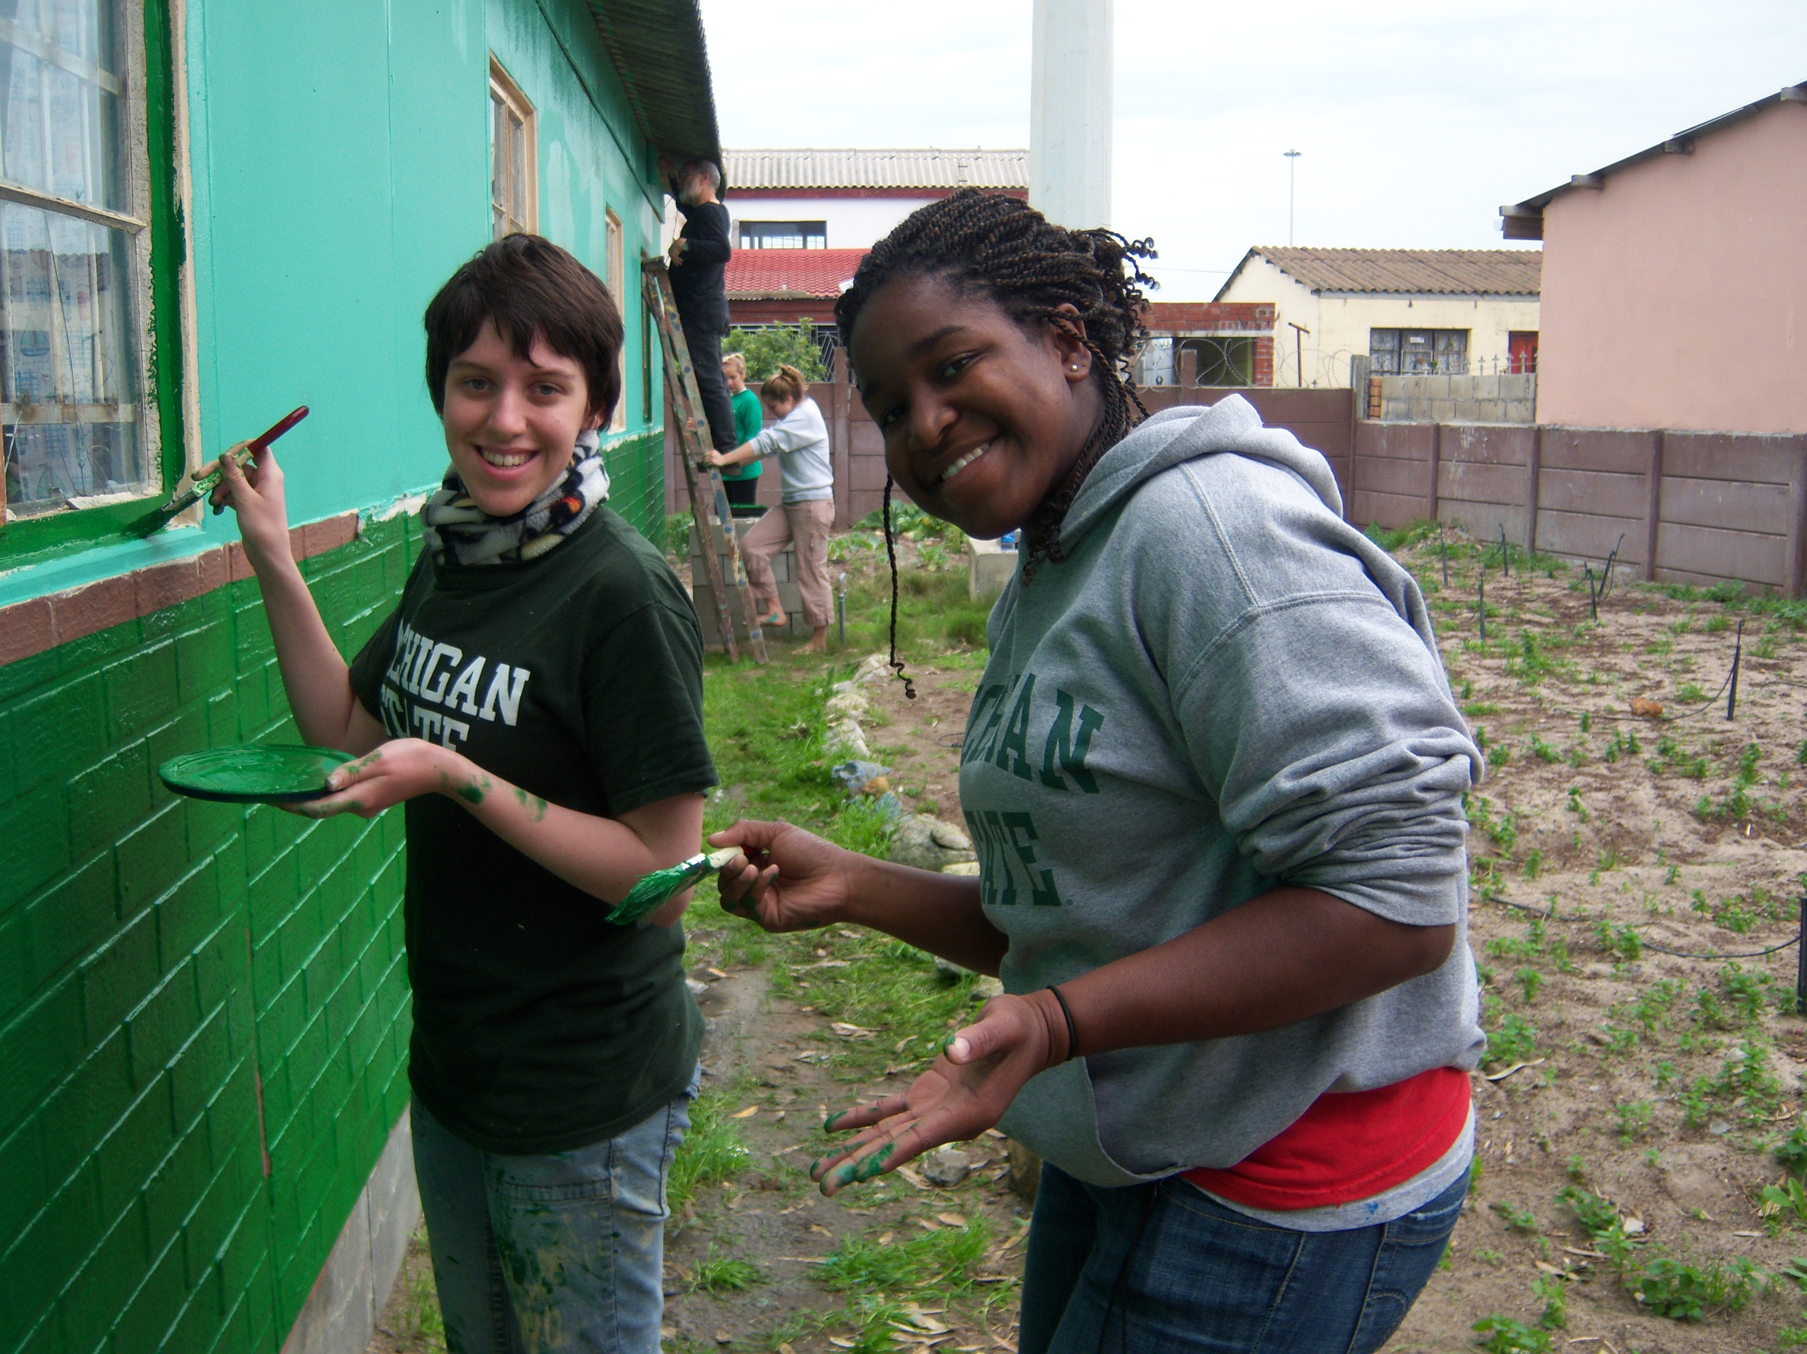
Study Abroad and the Title VI Agenda
Undergraduates:
** Increases knowledge of, competency in and commitment to international/area studies;
**Increases the number of Area Studies courses available for undergraduate students
** Increases options in Less Commonly taught Languages (African, Asian, etc)
** Facilitates access to, completion of Area Studies Specializations, minors, and majors.
** Facilitates disciplinary specific and professional internships
** Facilitates the commitment of students committed to developing expertise in development and justice related professions (agriculture, health, education, resource development, human rights, etc)
**Facilitates Service-Leaning opportunities.
* * Increases inter-cultural awareness & sensitivity

Slide 14
Study Abroad and the Title VI Agenda
Graduate Studies
** Provides pre (pre)-dissertation experience that is thematically and regionally focused
** Opportunity to increase language competency
** Opportunity for professional experience as program assistant

Slide 15
Study Abroad and the Title VI Agenda
III. Outreach
** Recruitment of (providing access to) students from institutions and consortia that do not have active programs in non-traditional areas of the world (Community Colleges, HBCUs, HSUCs, etc.)
** Consult with colleges and consortia (HBCUs, COE, MIIIE) and colleges on the development and sustainability of high quality, (institutionally appropriate) programs in non-traditional regions.

Slide 16
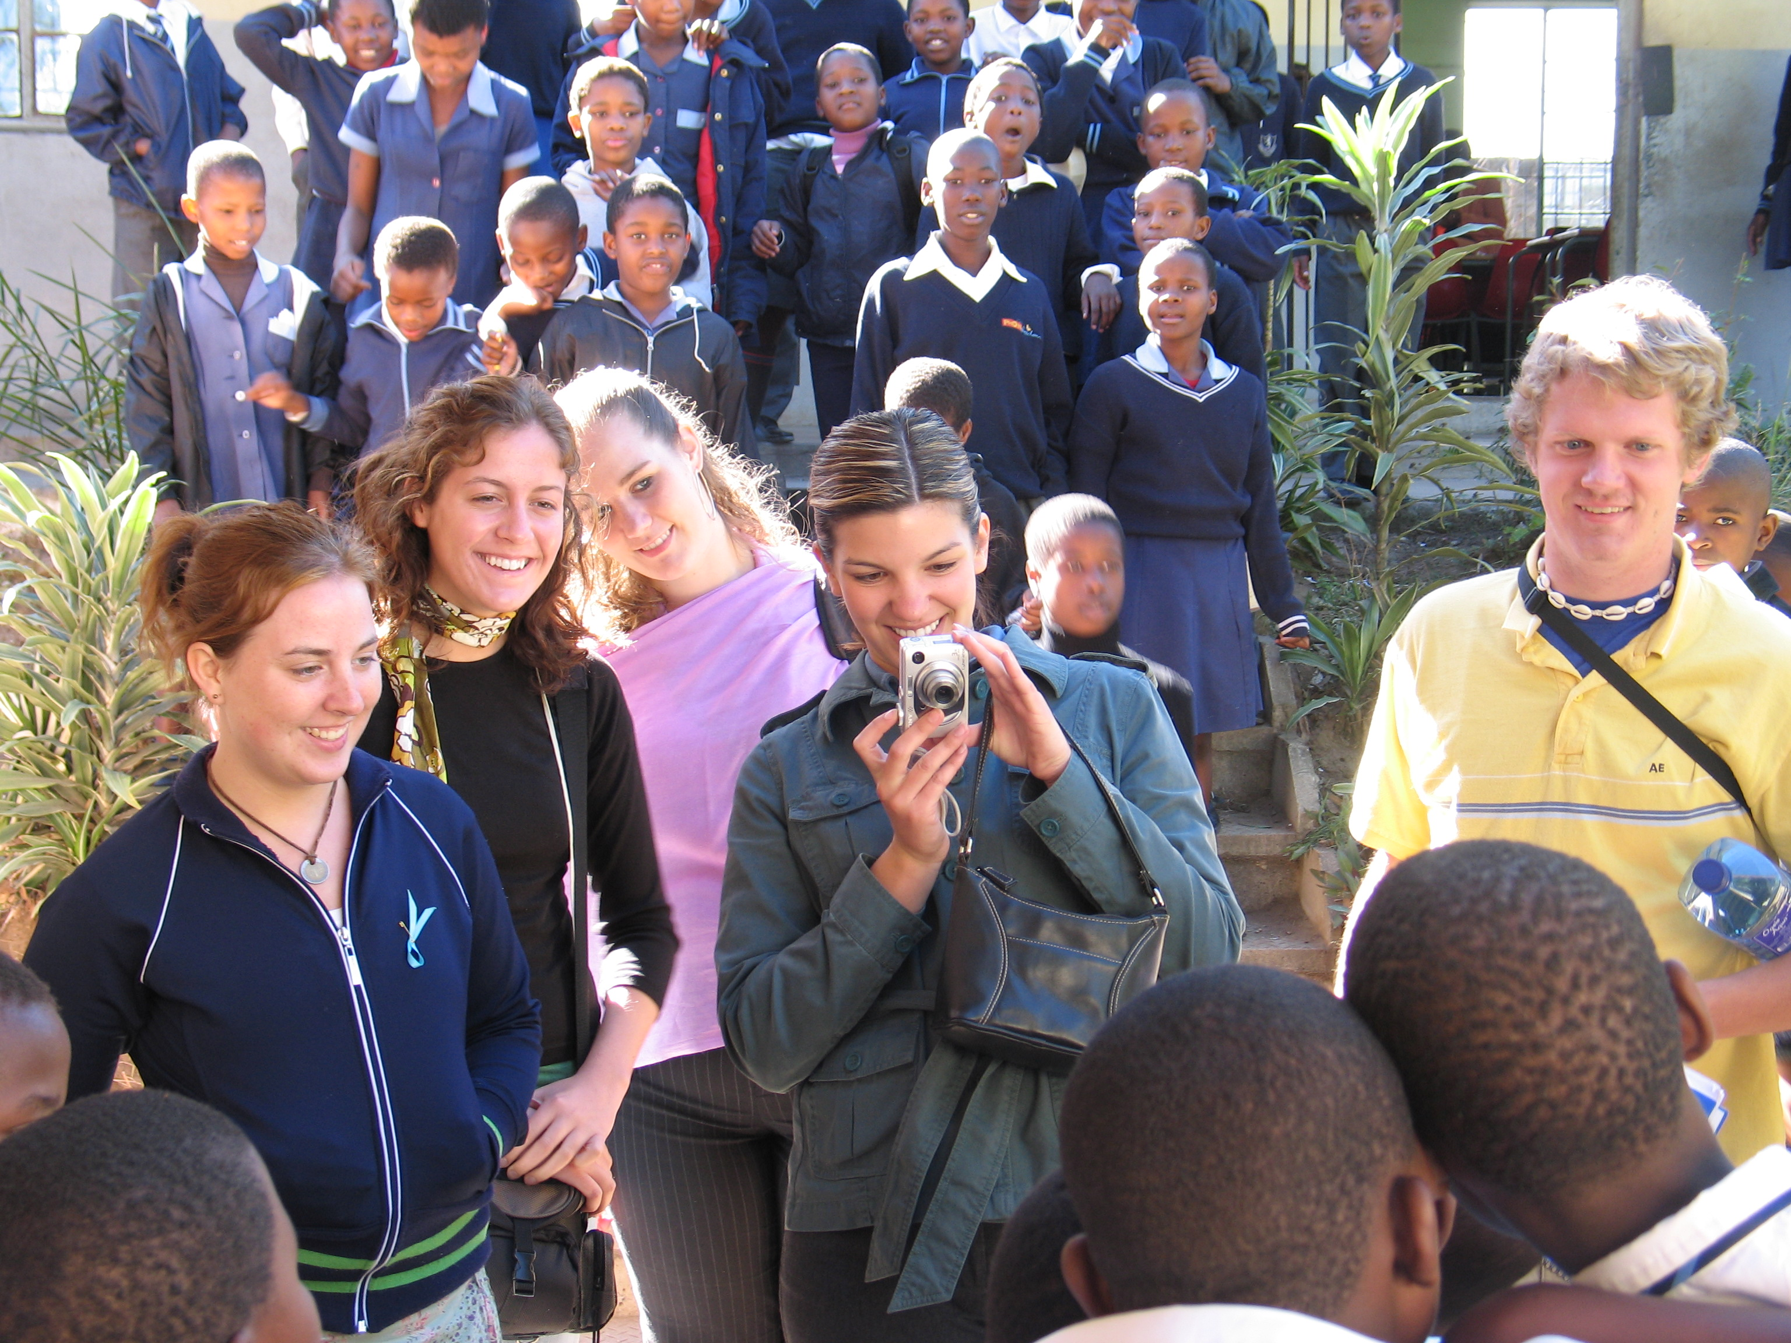
Study Abroad and the Title VI Agenda
IV. Institutional
** Increased area studies course offerings across the curriculum
** Increased instructional access to Less Commonly Taught Languages for undergraduates
** Facilitates area studies specialization and minor
** Facilitates increased access to thematic and professional internship opportunities
** Facilitates collaboration with professional schools (business, criminal justice, education, engineering, law, nursing, nutrition, medical (human and animal)
** Facilitates the development of a new cadre of area/international thematic and development focused professionals
** Facilitates a constituency of supporters and advocates for international education and global competency
** Solidifies institutional linkages with area universities and NGOs through transparent, equitable, and mutually beneficial programming.

Slide 17
Thank You

